Slide 1
COURSERA CAPSTONE IBM APPLIED DATA SCIENCE CAPSTONE
Setting up a shopping mall in Hyderabad,India
DONE BY
MATHANG PEDDI

Slide 2
BUSINESS PROBLEM
• Location of the shopping mall is one of the most important decisions that will determine whether the mall will be a success or a failure.
• Objective: To analyse and select the best locations in the city of Hyderabad,India to open a new shopping mall.
• This project is timely as the city is currently suffering from oversupply of shopping malls.
• Business question
➢In the city of Hyderabad, if a property developer is looking to open a new shopping mall, where would you recommend that they open it?

Slide 3
DATA
• Data required
➢List of neighbourhoods in Hyderabad
➢Latitude and longitude coordinates of the neighbourhoods
➢Venue data, particularly data related to shopping malls
• Sources of data
➢Wikipedia page for neighbourhoods
(https://en.wikipedia.org/wiki/Category:Neighbourhoods_in_Hyderabad,_India)
➢Geocoder package for latitude and longitude coordinates
➢Foursquare API for venue data

Slide 4
METHODOLOGY
• Web scraping Wikipedia page for neighbourhoods list
• Get latitude and longitude coordinates using Geocoder
• Use Foursquare API to get venue data
• Group data by neighbourhood and taking the mean of the frequency of occurrence of each venue category
• Filter venue category by Shopping Mall
• Perform clustering on the data by using k-means clustering
• Visualize the clusters in a map using Folium

Slide 5
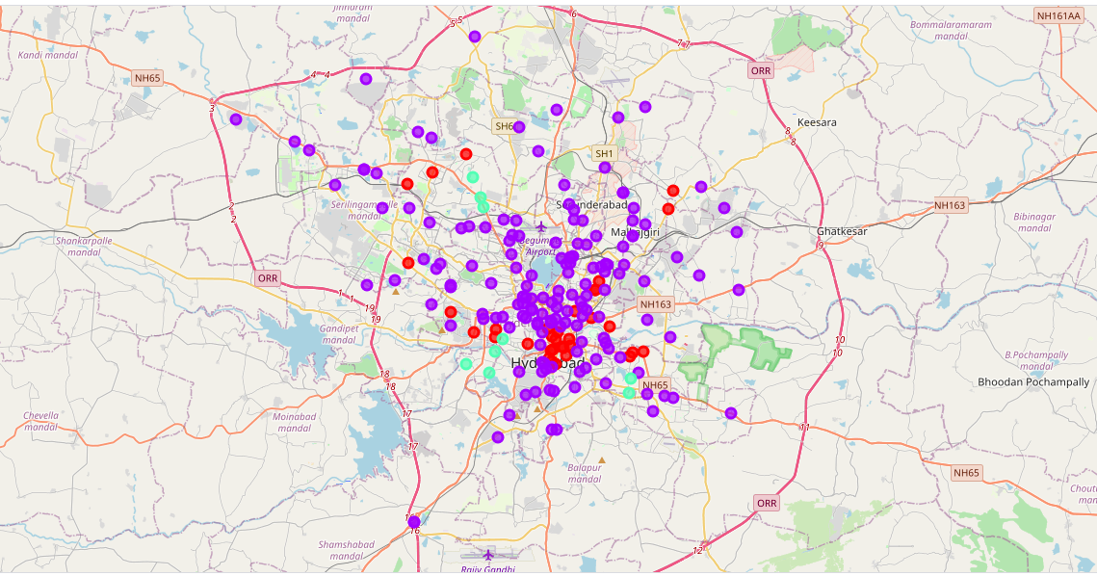
RESULTS
• Categorized the neighbourhoods
into 3 clusters :
➢Cluster 0: Neighbourhoods with
moderate number of shopping malls
➢Cluster 1: Neighbourhoods with
very high number concentration of shopping malls
➢Cluster 2: Neighbourhoods with very low number of shopping
malls.

Slide 6
DISCUSSION
• Most of the shopping malls are concentrated in the central area of the city
• Highest number in cluster 1 and moderate number in cluster 0
• Cluster 2 has very low number to no shopping mall in the neighbourhoods
• Oversupply of shopping malls mostly happened in the central area of the city,with the suburb area still have very few shopping malls.
•Therefore,the project recommends the property developers to capitalize on these findings to open new shopping malls in neighbourhoodsin cluster2 with little or no competition.

Slide 7
RECOMMENDATIONS
• Open new shopping malls in neighbourhoods in cluster 2 with little to no competition
• Can also open in neighbourhoods in cluster 0 with moderate competition if have unique selling propositions to stand out from the competition.
• Avoid neighbourhoods in cluster 1, already high concentration of shopping malls and intense competition.

Slide 8
CONCLUSIONS
• Answer to business question: The neighbourhoods in cluster 2 are the most preferred locations to open a new shopping mall
• Findings of this project will help the relevant stakeholders to capitalize on the opportunities on high potential locations while avoiding overcrowded areas in their decisions to open a new shopping mall.

Slide 9
THANK YOU!

